Slide 1





001: No time to spy. Build your "James Bond" style Power Apps game
POWER PLATFORM SATURDAY
Sydney - 2020
Olena Grischenko (MVP)
Andrew Grischenko
Technomancy

Slide 2

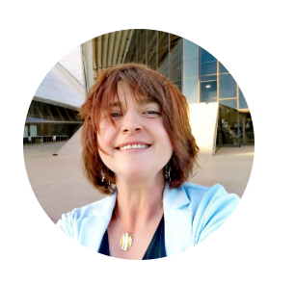

Who we are
Independent IT consultants
Solving technology problems for business
Software development, cloud
Power Platform – apps, Portal Automate etc.
#PowerLabs meetup organisers

Slide 3

What PowerLabs meetup is
https://www.meetup.com/PowerLabs/
Experiential learning
Non-competitive
Free and open
Not for profit

Slide 4
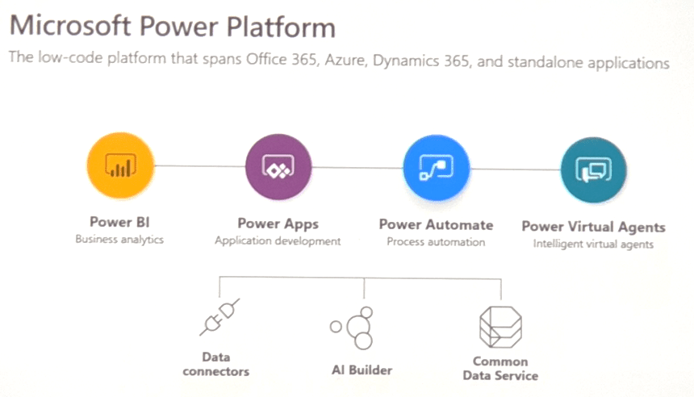
What’s Power Platform?

Slide 5

Video Games Industry

Slide 6
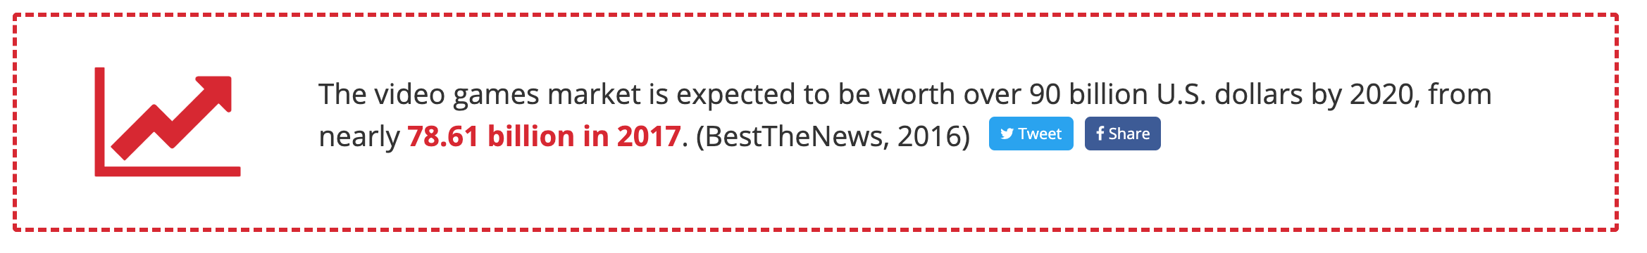
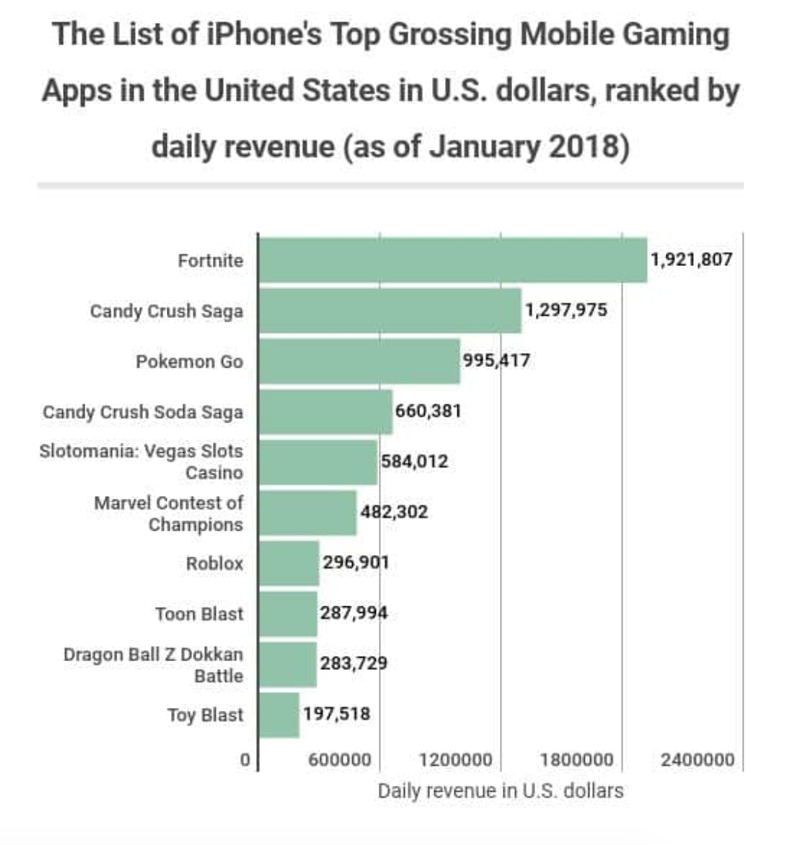
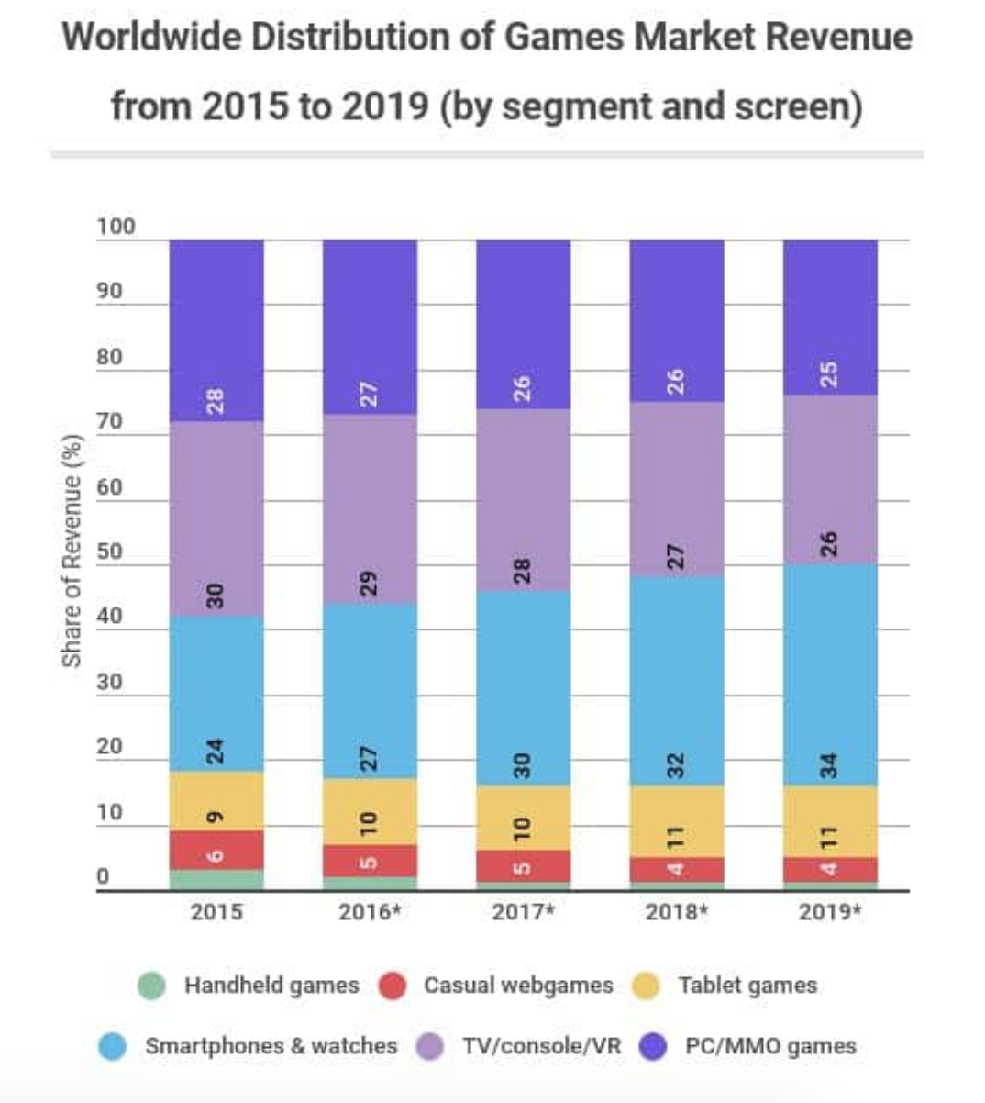
Video Games Industry
Games are fun,
Let’s make one!
https://www.wepc.com/news/video-game-statistics/

Slide 7

Live Lesson
Raise you hand if you need help

Slide 8

Next steps
Add game timer
Add music & sound effects
Add leaderboard
Add start menu
more ideas…
True game dev: Unity Engine
https://unity.com/

Slide 9

Thank you

